Slide 1
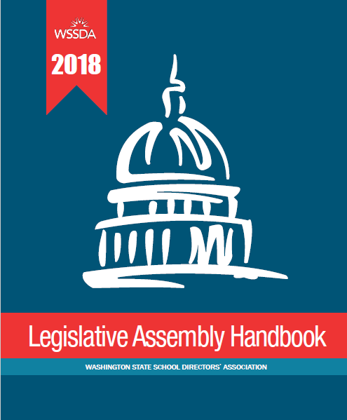

Get Ready for WSSDA’s 2018 Legislative Assembly
Preparing for WSSDA’s 2018 Legislative Assembly:
Part 2: The Assembly
September 7, 2018 Webinar

Slide 2

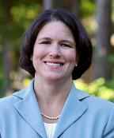
Welcome to the webinar!
Today’s presenters:
Carrie Sorensen, WSSDA Legislative Committee Chair,
Cascade School Board Director
Jessica Vavrus, WSSDA Deputy Executive Director,
Government Relations Lead
Please introduce yourself!
Type your name, school district, and role into the Question box

Slide 3
2018 Legislative Assembly Prep Two-Part
Webinar Series
Part 1: The Positions
Thursday, August 9, 12-1pm
Part 2: The Process
Friday, September 7, 12 – 1pm
Goal:
Support school boards in understanding and unpacking WSSDA’s legislative position proposals so that every school board in Washington is prepared to participate in the 2018 Legislative Assembly.
Recording and ppt available!
Goal:
Prepare school boards and their voting delegates to actively engage in the voting and prioritization process that takes place at the Legislative Assembly

Slide 4

    Webinar Logistics
Logistics
  Q&A / Comment process
    Question Box
    Hand Raise feature
  Phones/computers on mute
Webinar materials
  PowerPoint presentation & recording
    https://wssda.org/Events/LegislativeAssembly.aspx
  Positions Handbook & Resources Web page
    https://wssda.org/Events/LegislativeAssembly/HandbookforLegislativeAssembly.aspx
Notes:
Jessica

Slide 5
Today’s Focus: The Assembly
By the end of today’s webinar participants will understand:
The big picture
  WSSDA’s assemblies and why they’re important
  Legislative Assembly agenda
The Handbook – position proposals & learning resources
  Updates from 8/9 webinar
What to expect at assembly
  Agendas
  Voting process
  Prioritization process
What’s Next: Important activities prior to assembly

Slide 6
Big picture
WSSDA’s assemblies & why they’re important
2018 Legislative Assembly Preview

Slide 7
Democracy at Work:
WSSDA’s Legislative and Delegate Assemblies
 | Legislative Assembly | Delegate Assembly
Focus | Legislative Positions: Guide WSSDA’s year-round legislative advocacy efforts Communicate WSSDA’s viewpoint on a spectrum of state and/or federal legislative issues. Action-oriented Articulate desired legislative outcomes on behalf of the state’s public school districts | WSSDA Bylaws & Permanent Positions: Guide WSSDA’s work in all areas and are advisory to school boards. Communicate WSSDA’s foundational core principles on issues of widespread concern. Represent WSSDA’s beliefs and values. Set forth a variety of key conditions necessary for school districts to obtain success for each and every student.
WSSDA Committee | Legislative Committee | Resolutions Committee
Takes Place… | Every September Position solicitation, review, refinement takes place every March – May. | Every November In conjunction with WSSDA Annual Conference. - Position solicitation, review, refinement takes place every January/February – September.
Position Proposals Due | Late April / Early May | Mid-September (September 14th, this year!)
Notes:
Legislative positions are organized into 5 broad categories:
Learning
Teachers & Administrators
Capital facilities & School Construction
Funding & Allocations
Governance
Permanent Positions address topics in the following broad areas:
Association operations
District management (board members, general, equal rights, students
Finance (general, program funding, school construction, private schools, ESD funding)
Personnel (training, employment, contracts & negotiations, retirement)
Instructional Program (course design / instructional materials, instruction, controversial issues)
Relations with Others (federal relations, state relations, education organizations, regulatory agencies)

Slide 8
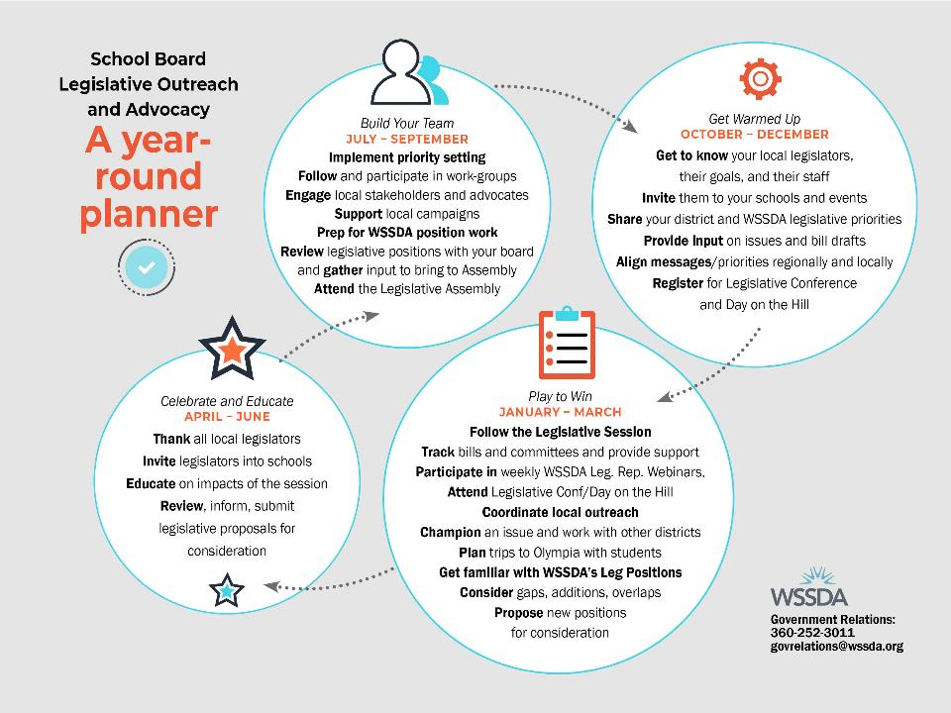
We are here…

Slide 9


2018 Legislative Assembly PREVIEW https://wssda.org/Events/LegislativeAssembly.aspx
September 21 & 22, Spokane, Davenport Grand Hotel
Note: September 14 is last day for early bird registration rate!
Pre-Assembly Day (Friday, 9/21)
WSSDA membership meetings
  Open to all!:
  Large Schools Caucus / Small schools
  roundtable / Equity & Access Caucus /
  Federal Relations Network (FRN)
  WSSDA Advisory Committees: Trust Lands
  “New to Assembly” meetings
Pre-Assembly Program – presentations & panel discussions on key issues/hot topics related to WSSDA’s legislative positions
Regional Director Area Caucus meetings
Assembly Day (Saturday, 9/22)
“New to Assembly” meeting
Position deliberations
Position prioritizing
Click Here for the Agenda Updated 9/7

Slide 10
The Handbook:
Position proposals & resources
Webinar 1 Recap
Handbook Overview
Update on “hot” position proposals

Slide 11
A Refresher
2018 Legislative Assembly Handbook
Handbook Web Page: https://wssda.org/Events/LegislativeAssembly/HandbookforLegislativeAssembly.aspx
Handbook Section | What’s in it? | How organized?
Front Matter | Welcome Agendas Assembly Procedures Prioritization Process Handbook Overview | Sequentially
Listing of Proposals & Positions (pp. 16-69) | Legislative position proposals (new and returning) for discussion. Includes proposed positions amendments and reference to SLPs to consider in prioritization process. | Regular Positions Calendar (Parts 1-4) Standing Positions Calendar REFERENCE: Standing Legislative Positions List
Position Learning Resources (p. 70-204) | Resources to support understanding WSSDA’s current legislative positions and learning on new policy issues on the docket for discussion at assembly. | Current position/session resources Topical resources for new proposals Funding & allocations Student & school safety High school pathways, assessments, graduation requirements

Slide 12
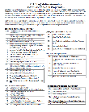
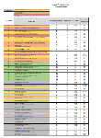
Navigating position listings:
Quick reference guides
Full listing of legislative positions (titles only) presented in two ways:
  Handbook order – this is the reference document you’ll use at assembly to keep track of position action and to prioritize your top 15 positions at the assembly
  Category order (by topics) – this document provides an overall look at the positions and proposals bundled by topic category.

Slide 13
A note on new position proposals… and learning resources available
New policy position topics (Regular Positions Calendar)
Funding & allocations (education funding policies)
  Hold harmless provisions (# 7, page 23, Part 1)
  Statewide bargaining for salaries (# 10, page 27, Part 1)
  Levy authority, Local Effort Assistance (LEA) policies (# 16, page 36, Part 2)
  Regionalization methodology (# 25, page 45, Part 3)
  State salary schedule (# 30, page 48, Part 3)
Student & school safety
  New position proposals # 17, 20, 21, 22, 26, 29, 31
HS pathways, assessments, graduation requirements
  High School and Beyond Plans (# 1, page 18, Part 1)
  Linking graduation requirements and career pathways (# 24, page 44, Part 3)

Slide 14
The process
Roles
Voting procedures
Position prioritization

Slide 15
Roles
(for reference WSSDA operating policy 1290 & 1290P)
WSSDA Legislative Committee & staff
  Legislative Committee Chair: presides over assembly
  Committee Members: introduce proposals, vote counts, timing
  WSSDA Staff: resources, position background, current context
  Parliamentarian: guidance/support to chair, parliamentary procedure guidance
School board delegates
  Check-in morning of assembly, picks up credential packet (one per district)
  One delegate badge (pink) per district
  Only a single school director from a board can wear the voting delegate badge to engage in assembly proceedings (debate) and voting

Slide 16
Voting Process
(for reference WSSDA operating policy 1290 & 1290P)
Proposal introduced & seconded
  In order as presented in the Handbook
Chair asks for amendments and/or discussion
  This is when delegates have an opportunity to propose changes/amendments to position proposal statements
Debate (Handbook page 13)
  Either on original proposal or proposed amendment/s
  Pro-Con-Pro
  All comments are timed (total time on any one issue/amendment = 10 minutes)
Vote (Handbook page 12)
  Regular – show of red/green cards
  Standing – Proponents stand with green cards and are counted; then opponents stand with red cards to be counted
  Weighted – on request of at least FIVE boards; weighted vote ballots found in delegate credential packets

Slide 17


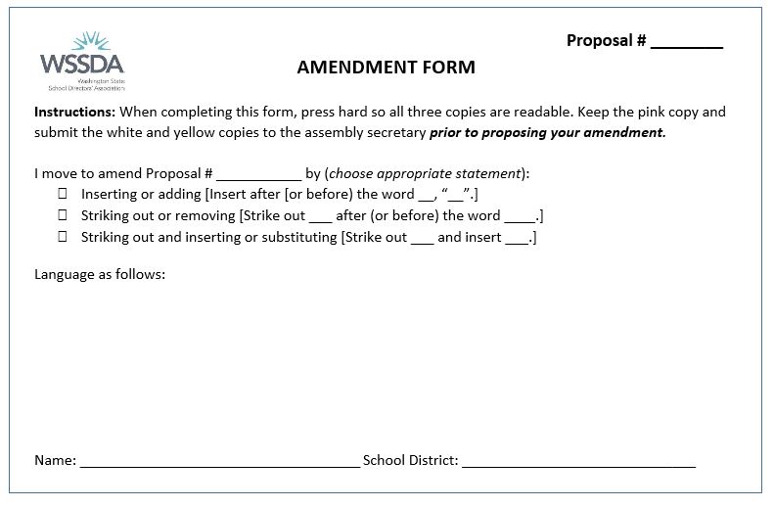

Process for addressing the assembly
(applies to all debate on position proposals & amendments)
District delegates (holding pink ribbons) only may approach microphones
Must be clear on intention
  Red/yellow/green card for debate
  Amendment motion
Debate sequence and time parameters (10 min total)
  Pro
  Con
  Pro

Slide 18
Position Prioritization Process for
2019 Legislative Platform
Following assembly voting:
Delegates rank top 15 legislative positions
  Use GREEN “List of Proposals and Positions” as guide
Two ways to prioritize (please pick one method):
  Electronic ballot (NEW!) – link will be available on the day-of assembly – accessible via mobile devices and laptops
  Paper ballot (Yellow) – customized for each district, available on request
Note: Each district may submit only one ELECTRONIC BALLOT OR YELLOW Priority Ballot on behalf of their board.

Slide 19




2017 Legislative Assembly Results =
2018 Legislative Positions & Priorities http://wssda.org/Legislative/OurPrioritiesPositions.aspx
88 school districts represented
47 positions debated (See 2017 Handbook for details)
Districts’ “top 20”priority rankings established WSSDA’s 2018 Legislative Priorities
(out of 104 total positions)
  Transitioning to a new funding model
  Supporting every students
  Investing in public school facilities
2018 Assembly = 2019 Legislative Positions & Priorities

Slide 20
Now what?
Steps for boards to take before assembly

Slide 21



Next steps for you & your board
Review position proposals – especially new positions and significantly amendments
  Consider your board / district’s position (questions? favor as-is?, oppose?, suggest changes/amendments?)
  Amendment form
Identify your board’s top 15-20 position priorities – have back-up positions identified in case there are changes/eliminations
Make sure you’re registered!
Attend assembly ready to engage!
Notes:
Jessica

Slide 22
Important dates
September 14
  Window closes for Permanent Position proposals (for Nov. Delegate Assembly)
  Leg. Assembly - Last day for early bird registration rate
September 21 & 22 – Register today for 2018 Legislative Assembly, Spokane
October / November – WSSDA Legislative Committee and Board of Directors consider assembly priority ranking and adopt 2019 Legislative Platform
November 16-19 – 2019 Legislative Priorities Platform launched at WSSDA Annual Conference
January 14, 2019 – 2019 Legislative Session begins
Notes:
Jessica

Slide 23

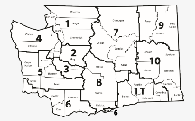
For more information…
Check out the web (https://wssda.org/Events/LegislativeAssembly.aspx)
Contact WSSDA (Jessica Vavrus, j.Vavrus@wssda.org and/or Logan Endres, l.endres@wssda.org)
Reach out to your region’s Legislative Committee Members (https://wssda.org/Legislative/LegislativeCommittee.aspx)

Slide 24
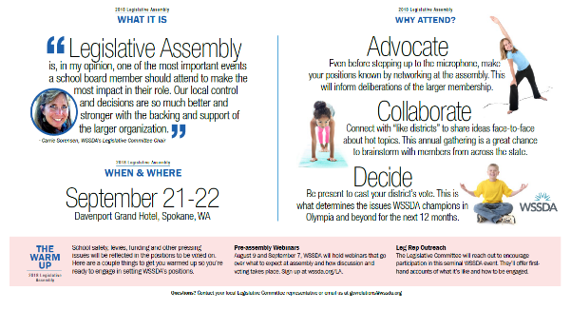
Thank you and see you in Spokane!

